Slide 1

Elastic Search Investigation
Dec 2022

Slide 2
Agenda
What is our goal?
Steps taken to reach the goal
What is Elastic Search?
Why Elastic Search?
How Elastic Search Works
Use Cases of Elastic Search
What is Kibana?
Elastic Search with Kibana
What is Kafka?
Importing Data into Elastic Search
Text Regex Pattern
Elastic Search vs SQL
Elastic Search with Kafka and Spring
Sequential and Concurrent Performance
Scalability Performance
Pricing Options
DB recommended type(NoSQL)
Multi-threaded Performance
Updating Data based on business key
Transnationality of Log Messages
Fault Tolerance
Deployment Model
Logstash vs Kafka

Slide 3
What is our goal?
Enhancing “Dump/Audit” Mechanism using Elastic Search/Kibana/Kafka

Slide 4
Steps taken to reach the goal
Setup Elastic Search, Kibana, Kafka.
Finding a way to import large portions of real-life data from DBMS into Elastic Search.
Measure the difference in performance between using Elastic Search and regular DBMS for the dump and audit.
Developing a microservice in Spring that can consume data from Kafka topic and insert it into Elasticsearch index.
Measuring Sequential and Concurrent Performance in case we were successful in the previous point

Slide 5
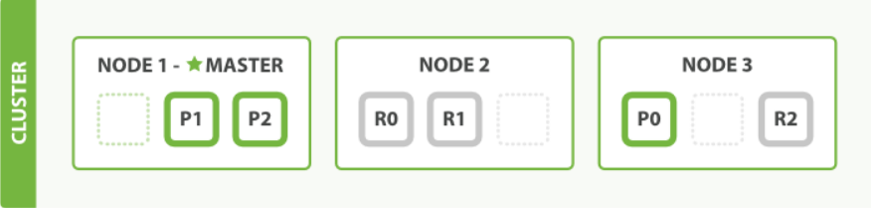
What is Elastic Search?
It is a distributed search and analytics engine, recently it has become the most popular search engine worldwide.
Commonly used for log analytics, full-text search, business analytics, and more.
It is a No SQL database that lets you create indices and perform API requests on it
It is scalable open source multitenant-capable, full-text, distributed search, and analytics engine
Its main components are:
Cluster
Nodes
Index
Shard

Slide 6
Why Elastic Search?
Since Products with huge databases are facing issues as very long time in retrieving data because relational database work comparatively slow when it comes to huge data and fetching search results through database queries which leads to poor user experience.
We want to use elastic search because
It has Simple REST API HTTP interface.
It uses schema-free JSON document
It can process large data in parallel
It supports many programming languages.
It supports a tool called Kibana that allows us to manage and visualize data inside the elastic search’s cluster.
It is scalable, we can easily add nodes to the cluster to increase capacity.

Slide 7
How Elastic Search Works
It can work in two ways:
Sending the data in the form of JSON document using API.
Using ingestion tools that visualize the data and build interactive dashboards such as Kibana, Logstash, and Amazon Kinesis Firehose.
Both ways enable elastic search to automatically store the document, add a searchable reference to the document in the cluster’s index, and let you search or retrieve data and find the best matches.

Slide 8
Use cases of Elastic Search
There are 2 main use cases of Elastic Search
Text Search (Search Engine)
When you are searching with a word or part of a word in a text (not selection something like category or something like that)
Log Analysis
Kibana which is used on top of elastic search will give us the ability to analyze our logs efficiently
We should not use Elastic Search as a primary database as it will cause some issues.
Elasticsearch won’t give you “atomic” blocks of transactions.
Performance issues
Any Schema/Mapping Changes require re-indexing.
The best use case is Elasticsearch is a sink in a data pipeline and with another system/database mastering the data.
In case of data loss, there is a way to replay data from upstream. So, your system/database would be a single source of truth and you could always flatten the tables and Index that data to ES and for search related to queries, you query ES and use system/database as is for usual application-DB transactions.

Slide 9

What is Kibana?
Kibana is a free and open frontend application that sits on top of the Elastic Stack, it is used for data querying and analysis.
Using various methods, users can search the data indexed in Elasticsearch for specific events or strings within their data for root cause analysis and diagnostics.
It helps in analyzing the data indexed in Elastic Search through the creation of bar charts, pie charts, tables, histograms, and maps.

Slide 10
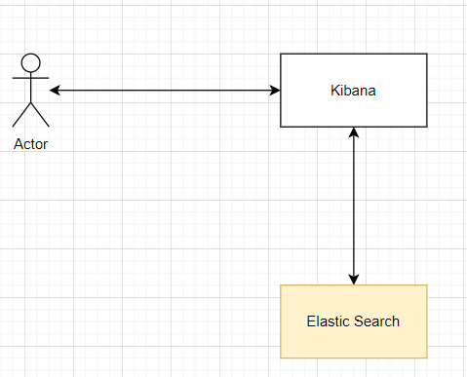
Elastic Search with Kibana

Slide 11
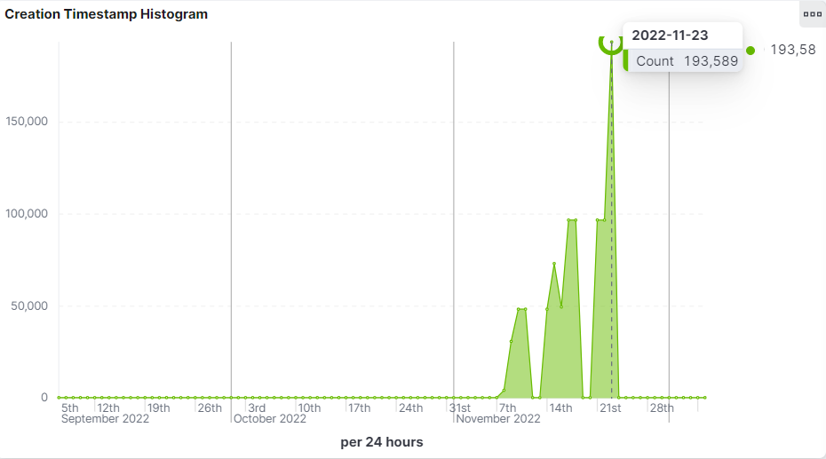
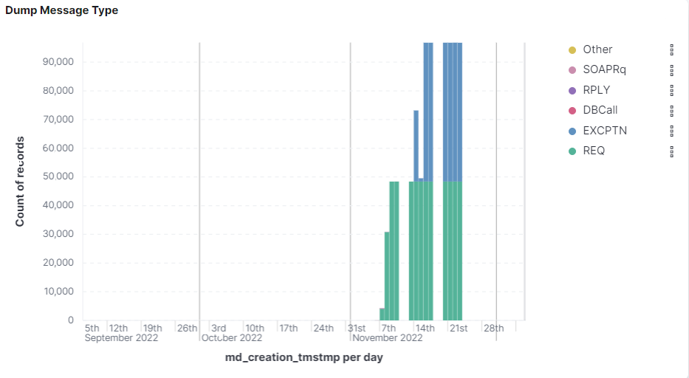
Elastic Search with Kibana
Visualization of Records in Kibana

Slide 12
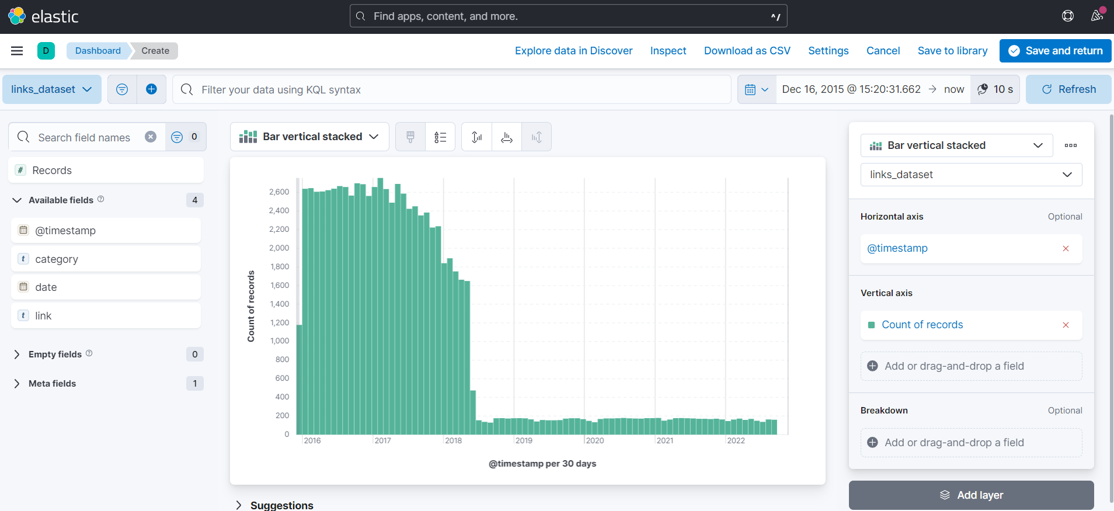
Elastic Search with Kibana
Visualization of Records in Kibana

Slide 13
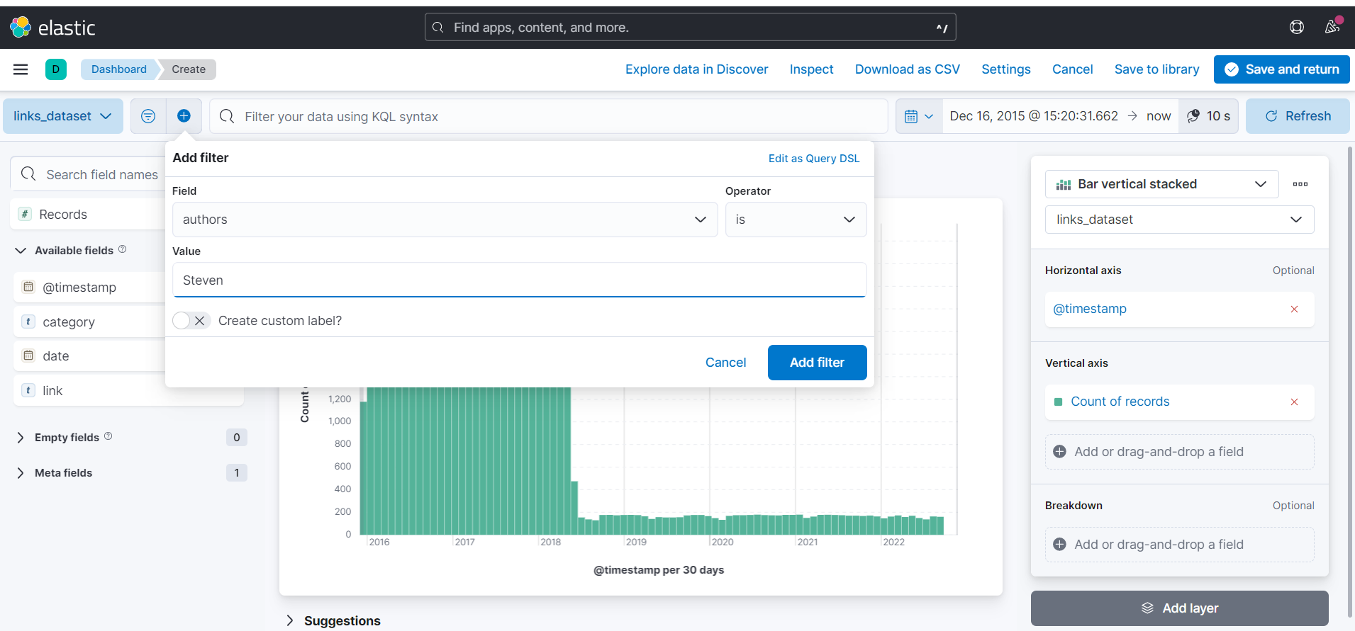
Elastic Search with Kibana
Filtering Visualized Records in Kibana

Slide 14
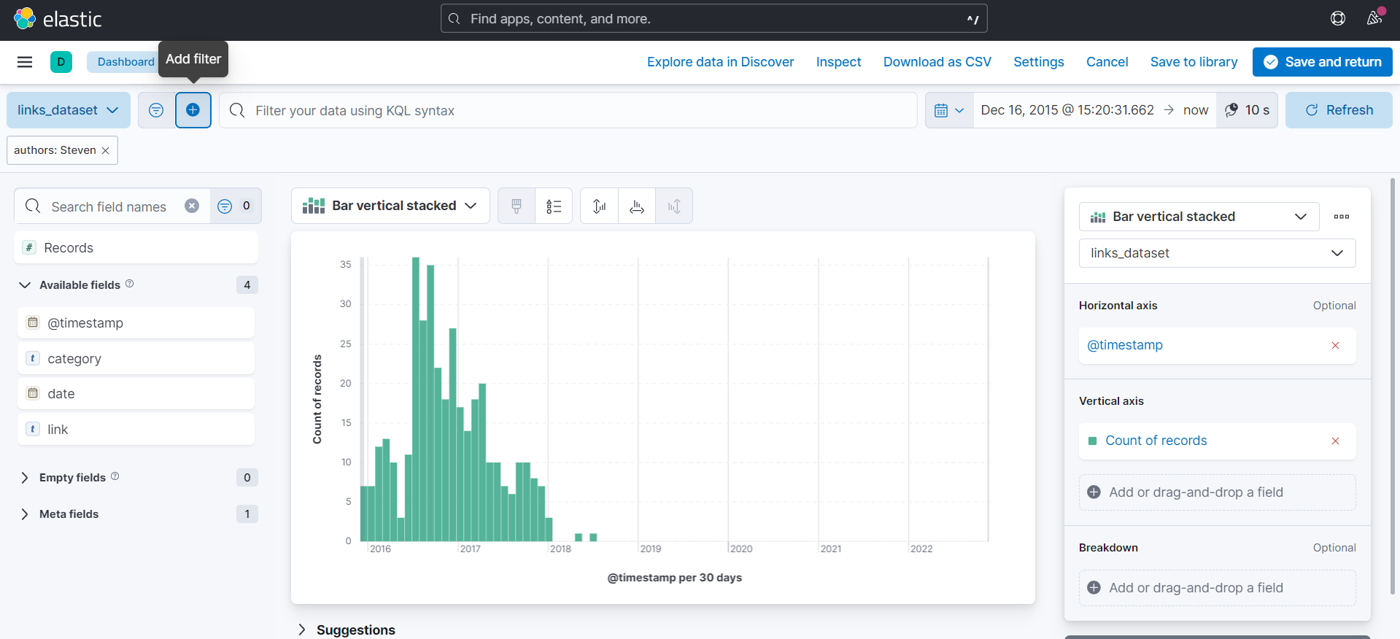
Elastic Search with Kibana
Visualized Records after Filtration in Kibana

Slide 15
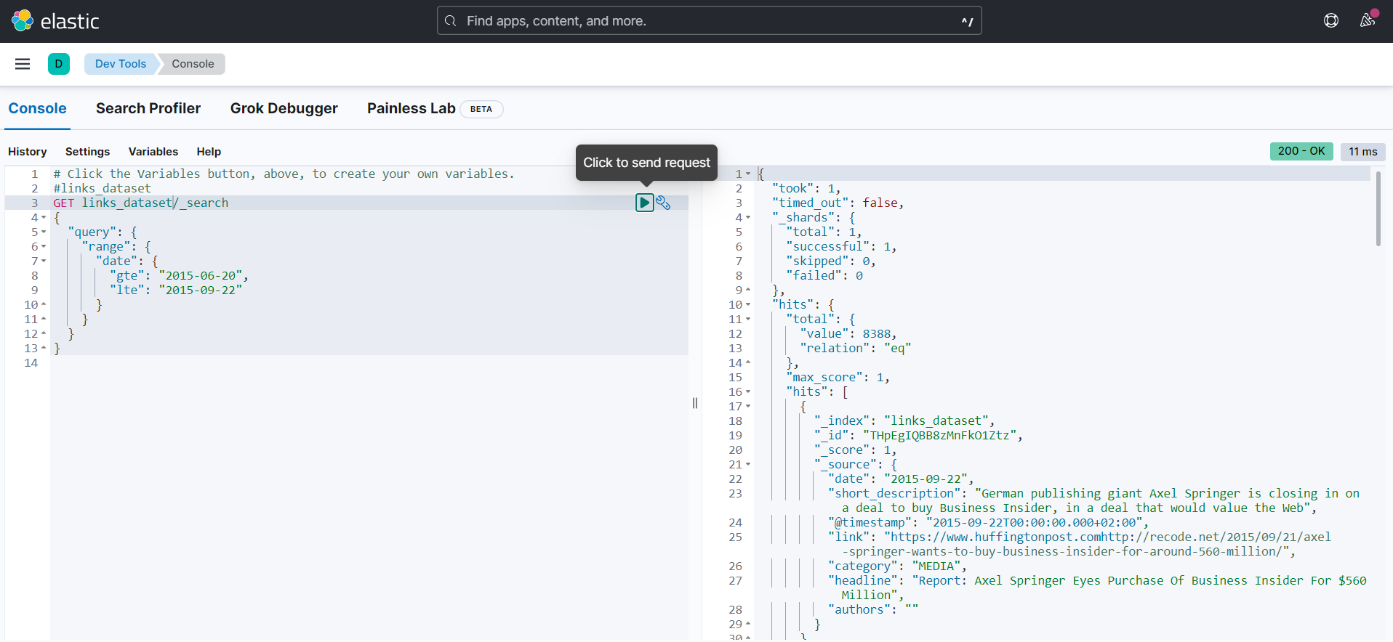
Elastic Search with Kibana
Using Console Queries in Kibana

Slide 16
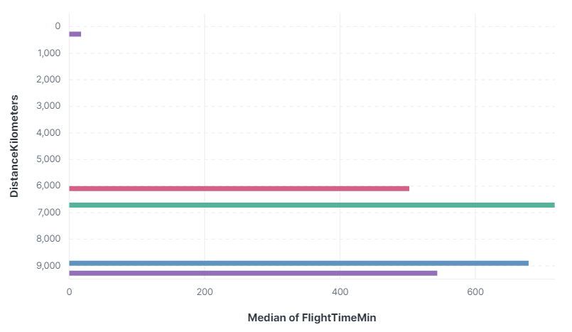
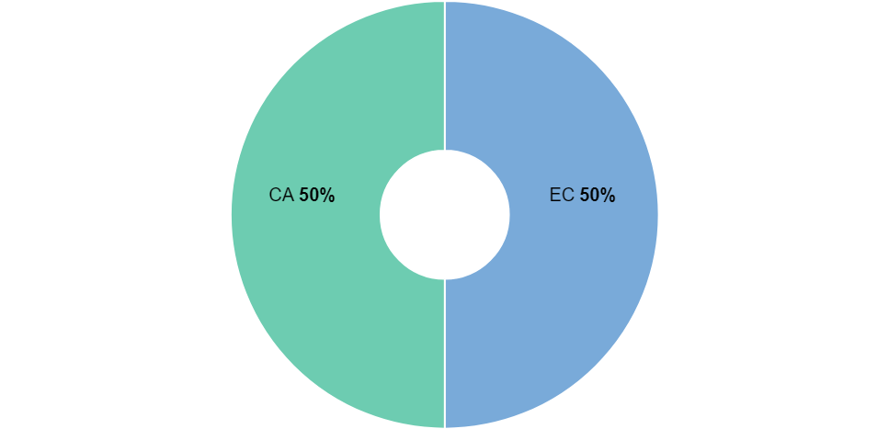
Elastic Search with Kibana
Statistics Visualization
Pie Charts to view percentage
of each value in a specific field
Horizontal Bar Charts

Slide 17
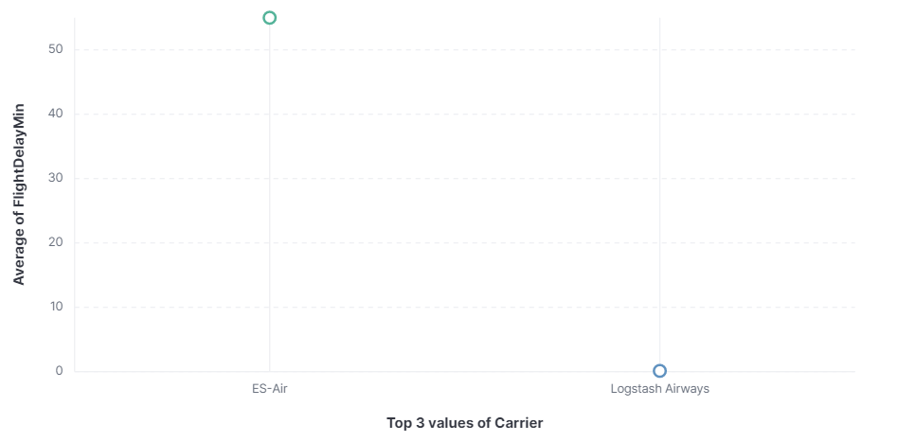
Elastic Search with Kibana
Statistics Visualization
Scatter Plot

Slide 18
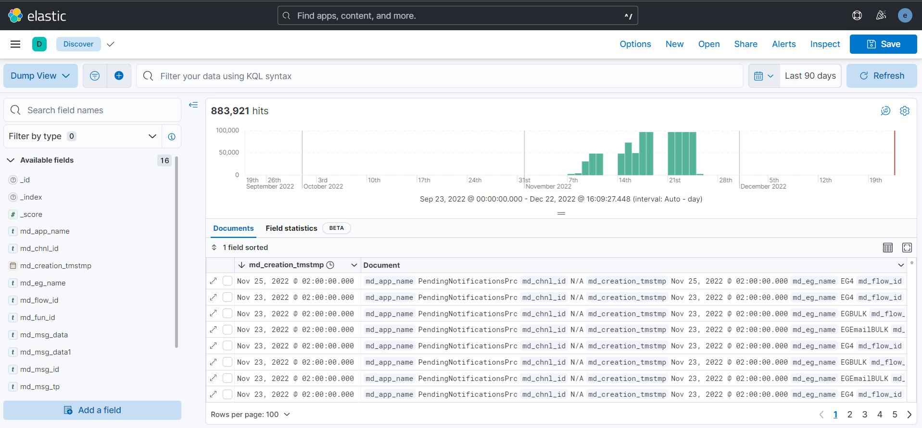
Elastic Search with Kibana
View Data In Table

Slide 19
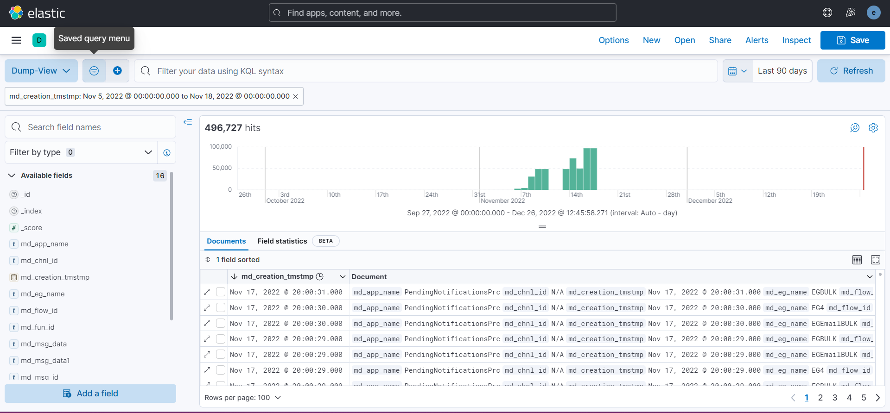
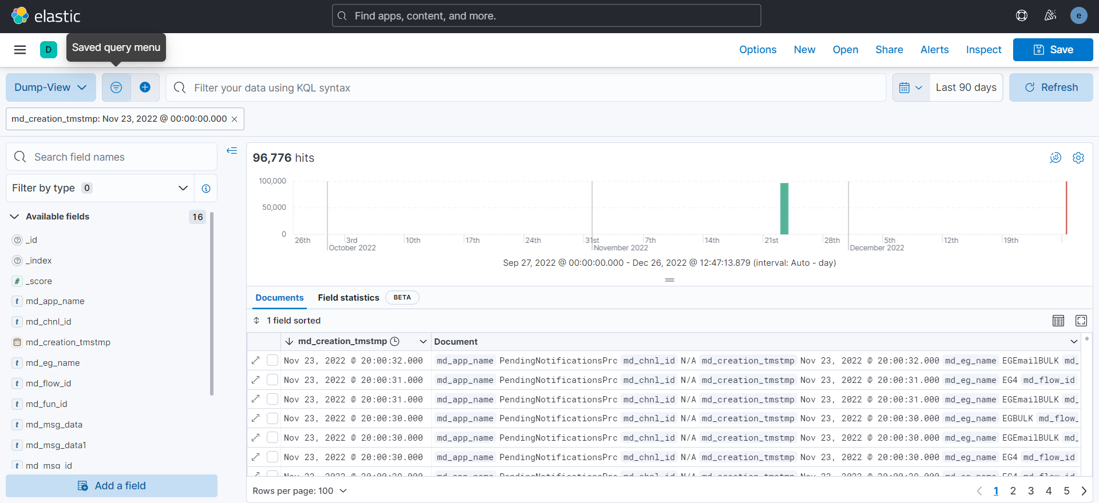
Elastic Search with Kibana
Filtering Data in Table

Slide 20
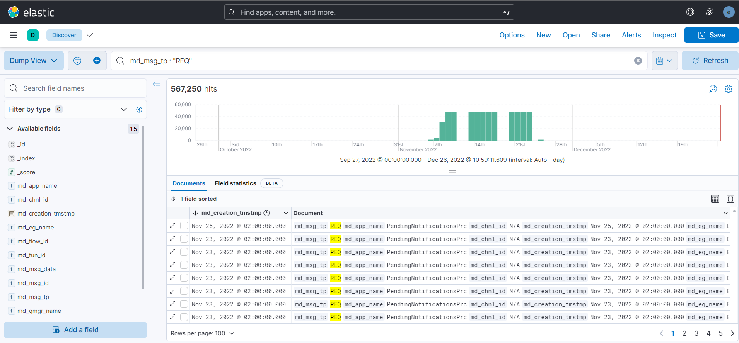
Elastic Search with Kibana
Filtering Data in Table

Slide 21
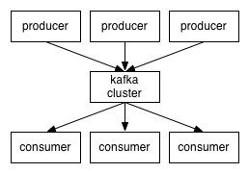
What is Kafka?
It is an event streaming platform that enables us to
publish (write) and subscribe to (read) streams of events, including continuous import/export of your data from other systems.
store streams of events durably and reliably for as long as you want.
process streams of events as they occur or retrospectively.
It is a distributed system consisting of servers and clients that communicate via a high-performance TCP network protocol. It can be deployed on bare-metal hardware, virtual machines, and containers in on-premise as well as cloud environments.
Its main components are:
Event
Topic
Producer
Consumer

Slide 22
Text Regex Pattern
In Elastic Search, we want to analyze some text to create the inverted index. The analyzer we will use is the pattern analyzer. This takes in a regex and treats whatever in the regex as a separator and separates the input text accordingly. The separated text bits form the tokens which form the inverted index.
For example,
If we have the following string

Slide 23
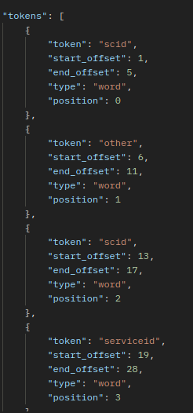
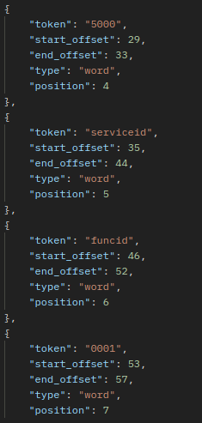
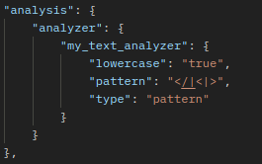
Text Regex Pattern
If we use the pattern analyzer to separate this text at every opening and closing tag of the XML string, the following tokens will be generated
etc…
Pattern Analyzer
Generated Tokens

Slide 24
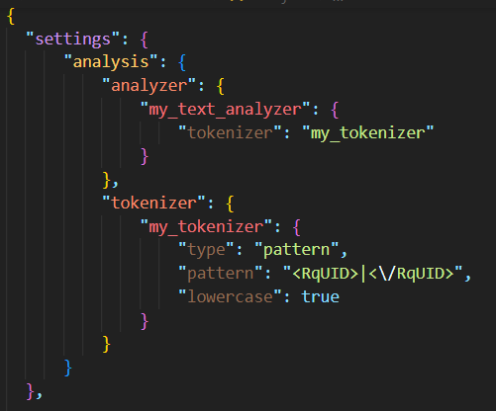
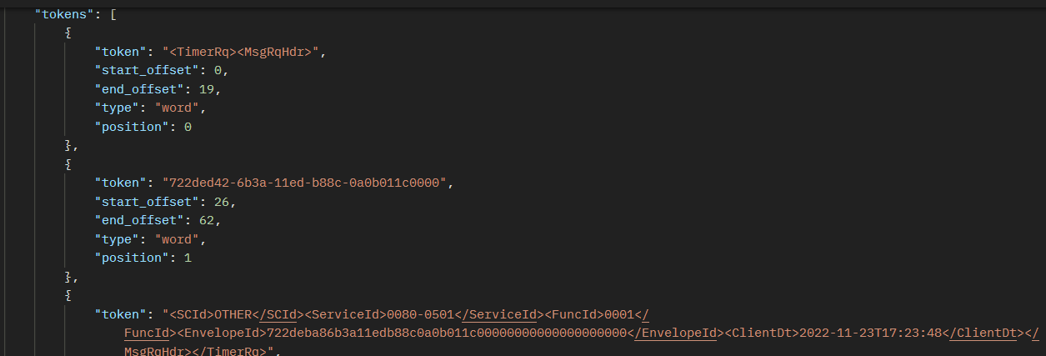
Test Regex Pattern
The previous pattern may be in-efficient, as it will generate a lot of redundant tokens that we may not need.
Instead, we try another pattern, to only tokenize the field we need, and treat the text before it as a single token and the text after it as a single token.
Pattern Analyzer
Generated Tokens

Slide 25
Elastic Search vs SQL
Elastic Search is way better in terms of a large amount of data being searched while SQL is better in terms of transactions and complex queries.
ES supports unstructured or semi-structured data while SQL supports structured data
To illustrate the difference in performance, we will use many records.
 | Oracle | Elastic Search
Number of Records | 883909 | 885049

Slide 26
Importing Data into Elastic Search
For small sized data, we can use Elastic Search’s Bulk API in order to index the data into the Elastic Search index.
For larger sized data, using the Bulk API to upload all this data at once is not a recommended solution, instead, we will be using a python script that will help us break the data into chunks and importing each chunk separately into Elastic Search.

Slide 27
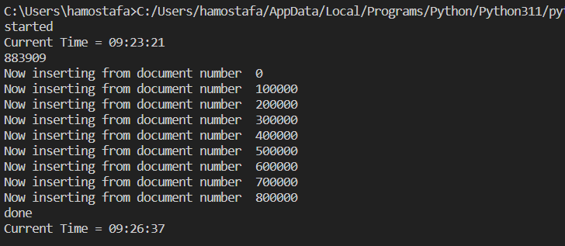
Elastic Search vs SQL
Measuring Performance Difference
Exporting/Importing Records
In case of oracle, exporting the records took up a huge amount of time(up to 2 hours).
In case of Elastic Search, some import methods took up the same amount of time, but with the help of the Python script(after separating the data into chunks), the data was imported in minutes.
Importing Elastic Search Records using Python

Slide 28
Elastic Search vs SQL
Measuring Performance Difference
Insertion of Records in Database
We notice that without the use of PL/SQL in oracle, the performance of Elastic Search is significantly better than oracle. With the use of PL/SQL in case of insertion of identical rows, the performance is somewhat close.
However, insertion in general is not our main issue, what we’re looking for is difference in performance in case of search queries.
 | Oracle | Elastic Search
Insertion of One Record | 0.21 | 0.033
Insertion of 2000 rows – without PL/SQL | 2.673 | 0.288
Insertion of 8000 rows – without PL/SQL | 156.898 | 0.419
Insertion of 10000 identical rows – with PL/SQL | 0.558 | 0.553
Insertion of 100000 identical rows – with PL/SQL | ~5 | ~5

Slide 29
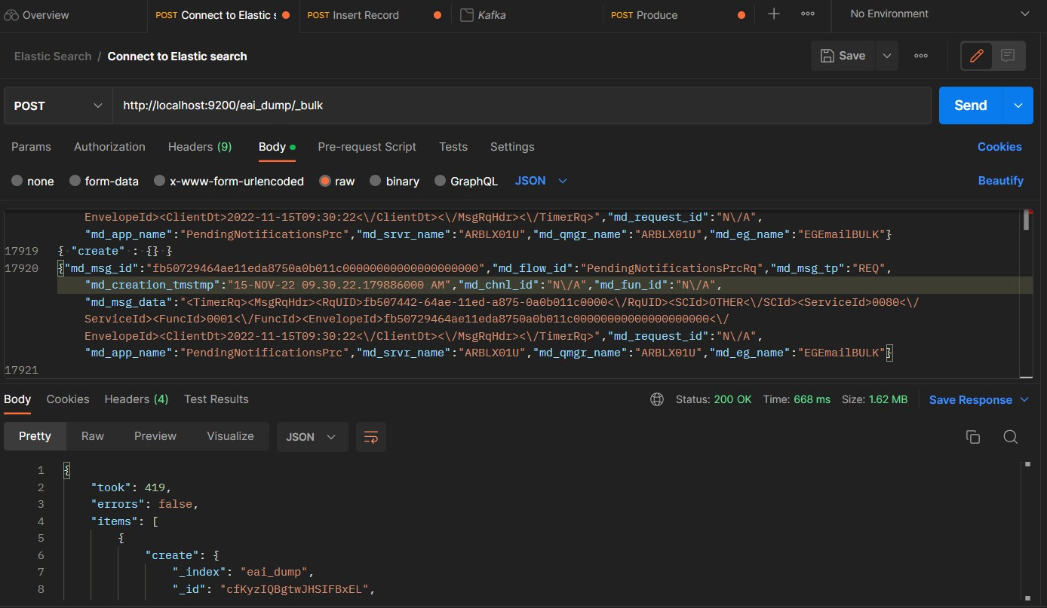
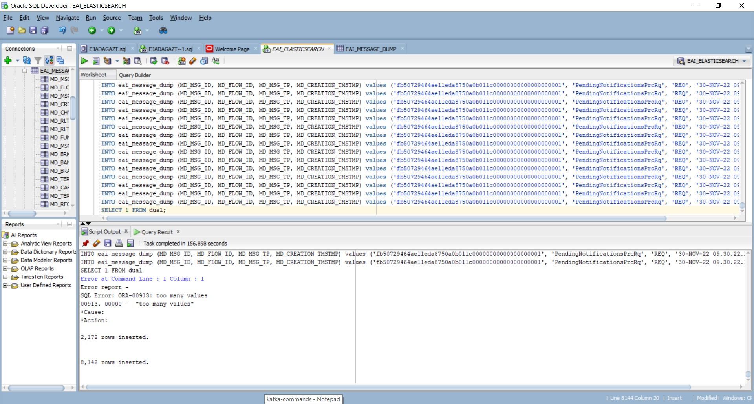
Elastic Search vs SQL
Measuring Performance Difference
Insertion of Records in Database

Slide 30
Elastic Search vs SQL
Measuring Performance Difference
Searching through the database
In case of searching with any query in general, Elastic Search shows a great difference. When we try to fetch for example 10000 records, oracle fetches these records in around 20 seconds, but elastic search fetches them in under 300ms, any other latency would be due to the layers the data passes through until it reaches the user, with the added latency elastic search would still be considered faster than oracle.
Example
 | Oracle | Elastic Search
Number of Records Fetched | 10,150 | 10000
Time Taken | 27.121 Seconds | 274ms

Slide 31
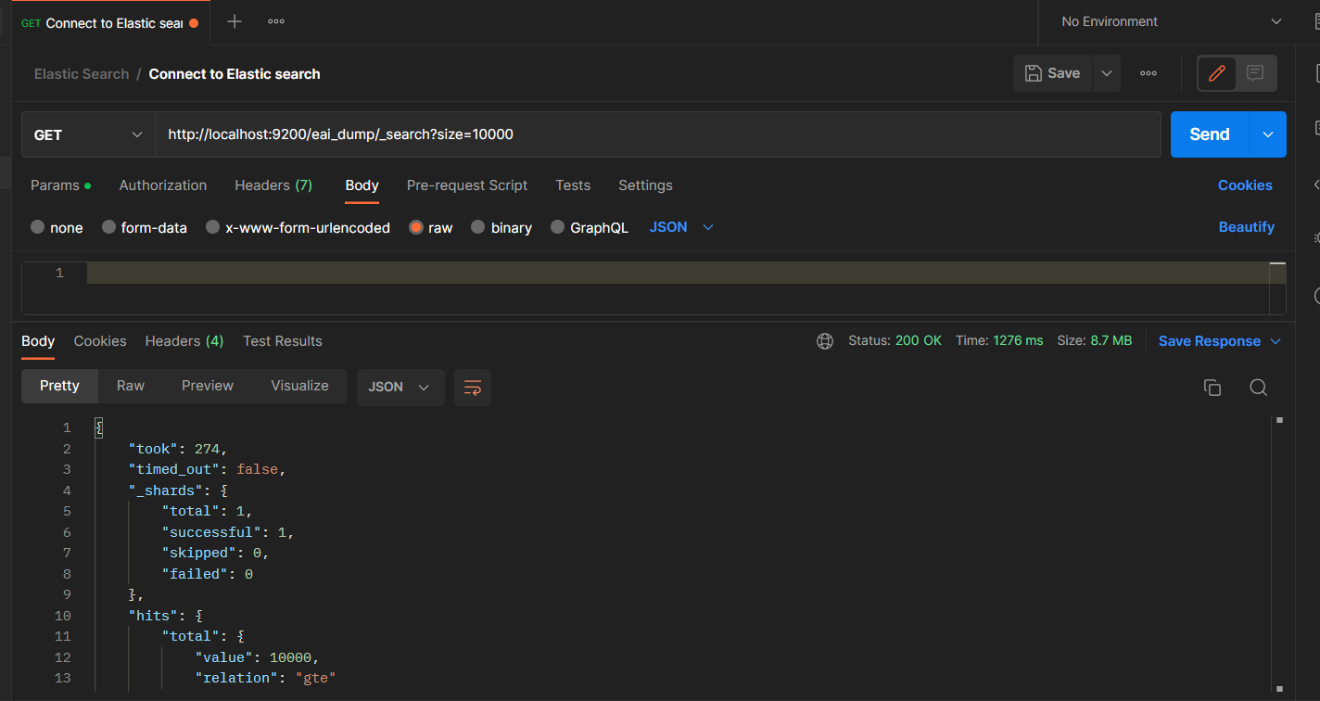
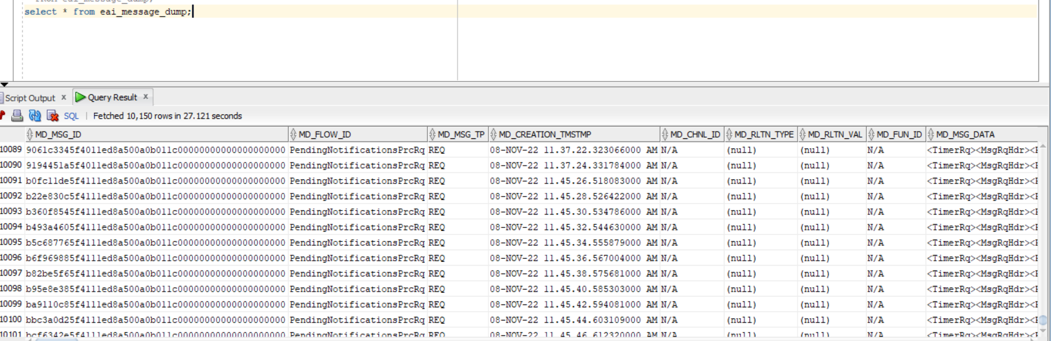
Elastic Search vs SQL
Measuring Performance Difference

Slide 32
Elastic Search vs SQL
Measuring Performance Difference
Searching through the database
As the number of fetched records increase, the time taken by oracle is still noticeably significantly higher than elastic search.
Furthermore, Elastic search wins in case of full text search as well, which would help us greatly if we were to search the dump message data.
Updating and Deleting Records in Elasticsearch
Updating and deleting are very similar to insertion.

Slide 33
Elastic Search vs SQL
Measuring Performance Difference
Storage Comparison
Storage size has decreased slightly as the number of tokens decreased, this can help us in case of large data that the inverted index size will decrease further more then.
 | Oracle | Elastic Search
Storage Size | 7.6GB | ~250MB

Slide 34
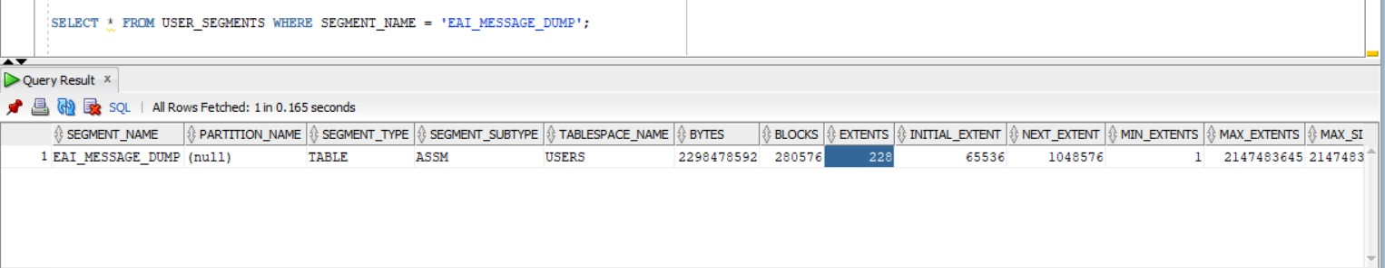
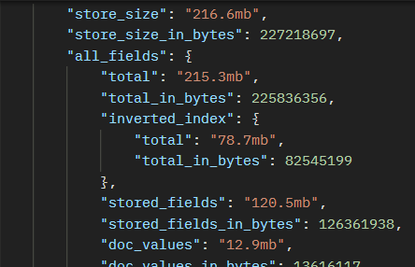
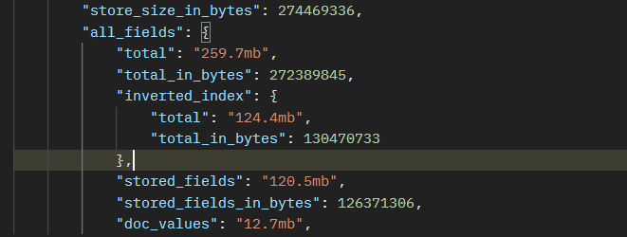
Elastic Search vs SQL
Measuring Performance Difference
Storage Comparison
In case of Oracle
In case of Elastic Search
Old Indexing Pattern
New Indexing Pattern

Slide 35
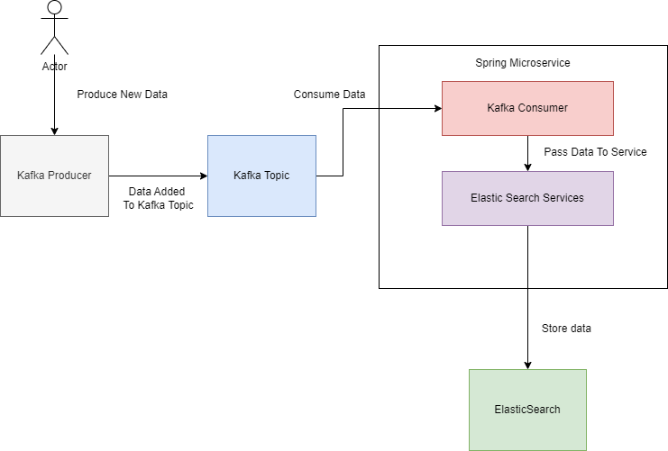
Elastic Search with Kafka and Spring

Slide 36
Elastic Search with Kafka and Spring
Explanation
When a user decides they want to store new data in Elastic Search, they send the data to Kafka topic and do not wait for a response, as it will be an asynchronous operation.
The data will then be stored in the Kafka topic waiting to be consumed by a Kafka consumer.
In our microservice, a Kafka listener is implemented, which is listening on the targeted topic waiting for any data to be added to it so it can consume it.
When it consumes the message, it is sent to the intended service that connects to the elastic search and stores the data in the targeted index.
Should the user decide to fetch or manage that data from Elastic Search later, he can do so using other services implemented in our microservice.

Slide 37
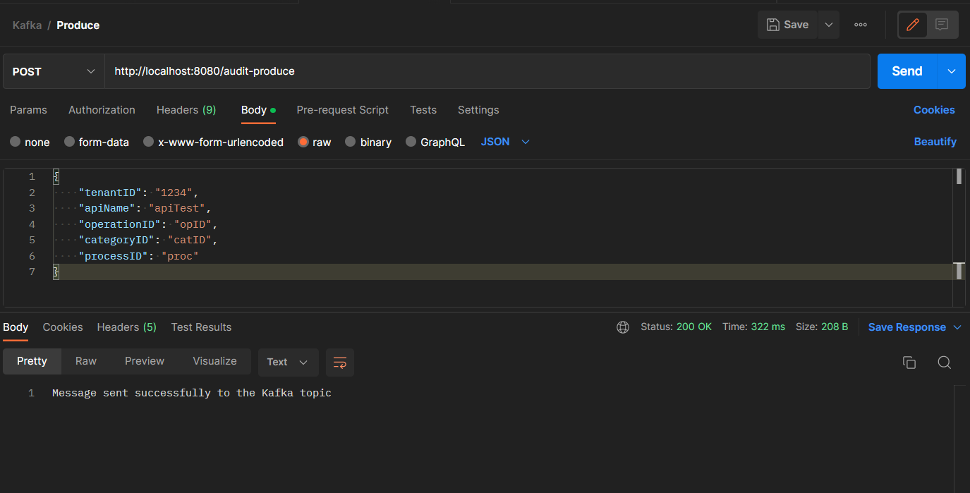
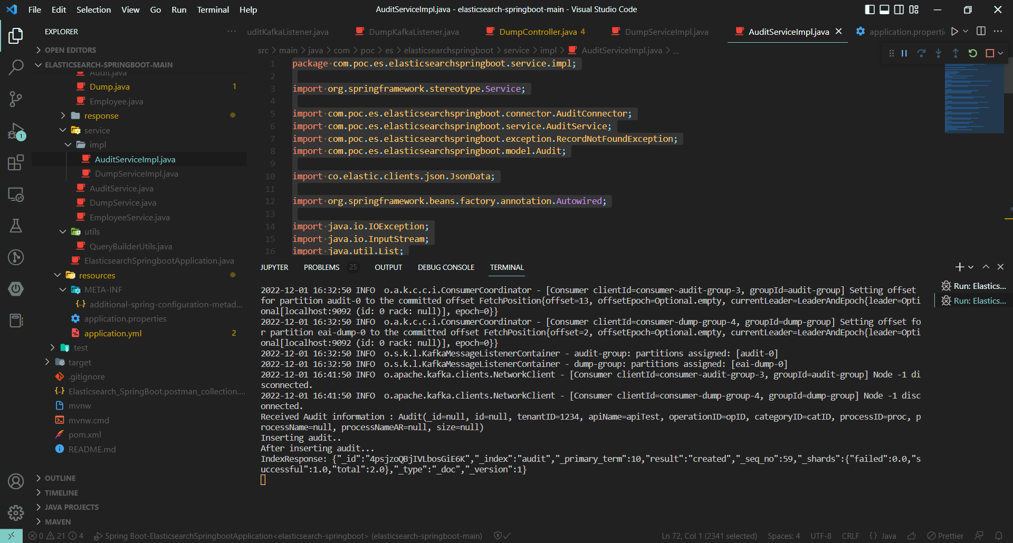
Elastic Search with Kafka and Spring
Testing Connections
Adding data to kafka using producer controller in ‘audit’ topic.
Consumer will automatically pull this data and insert it into elastic search
Producing Data in Kafka
Data Consumption and Storage
In Elastic Search

Slide 38
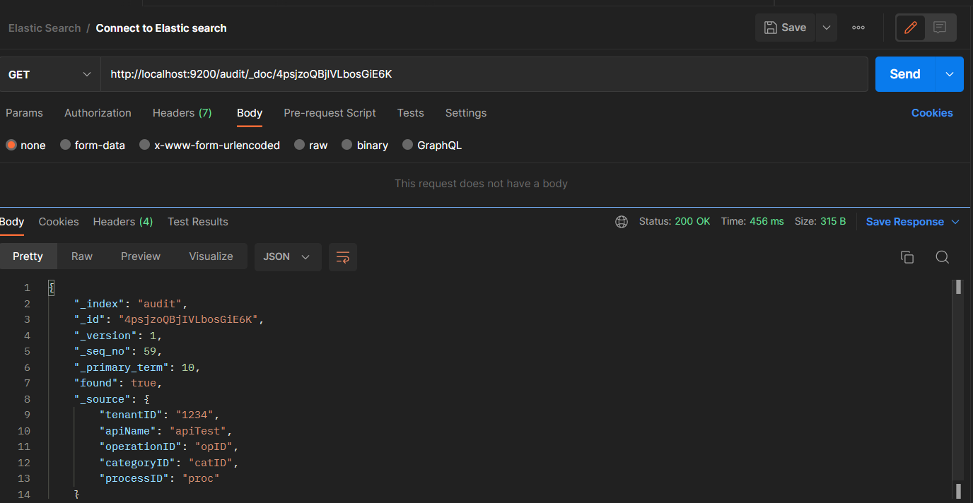
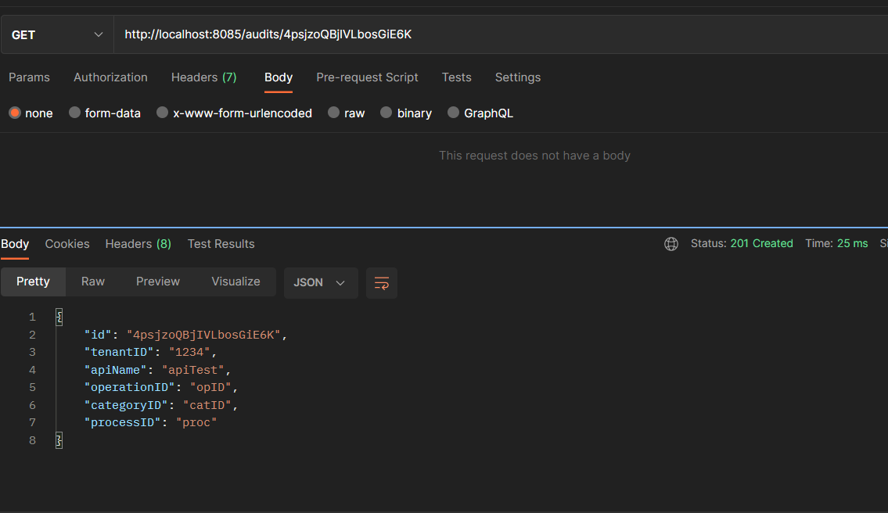
Elastic Search with Kafka and Spring
Testing Connections
We can verify that the data was successfully inserted into Elastic search by built-in api or implemented controller methods
Using Elastic Search API methods
Using implemented microservice

Slide 39
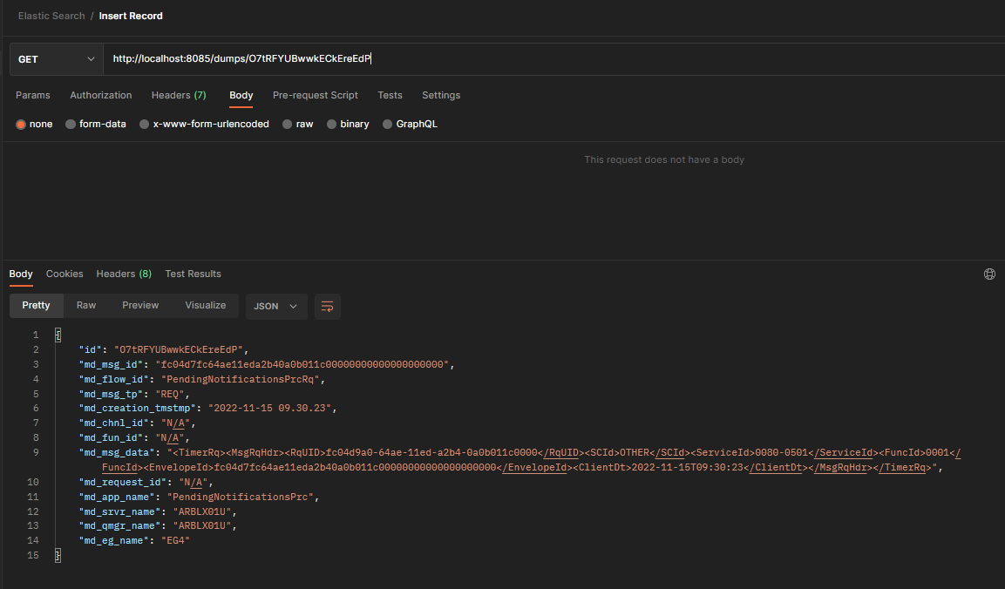
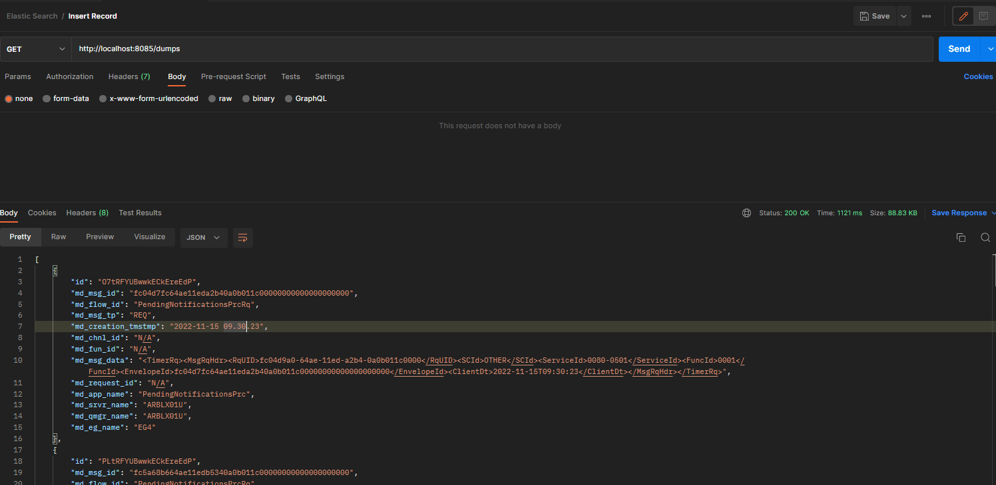
Microservice Capabilities
Fetch All Records
Fetch Record By ID

Slide 40
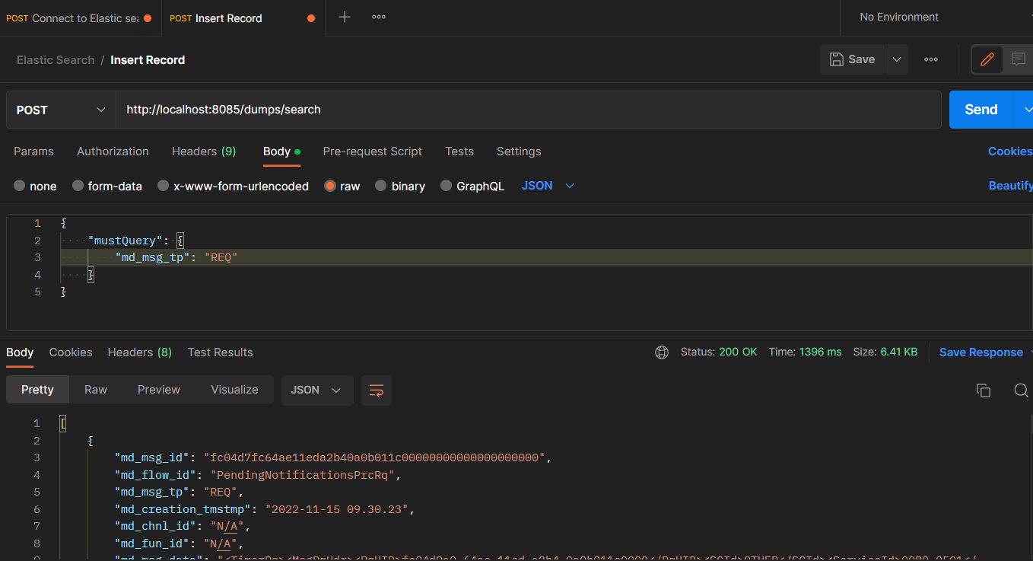
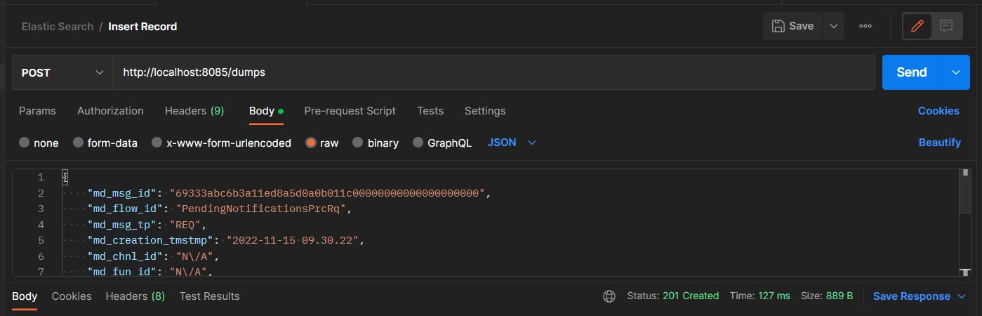
Microservice Capabilities
Insert Record
Search Records

Slide 41
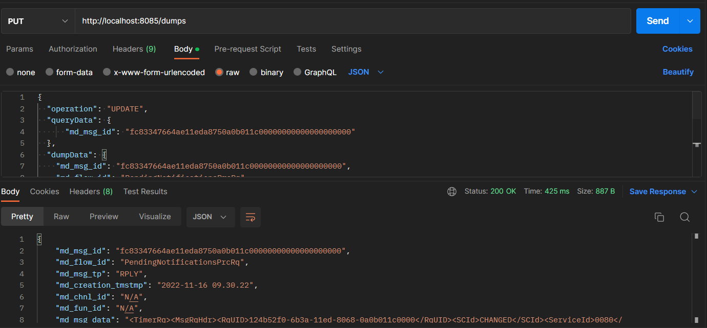
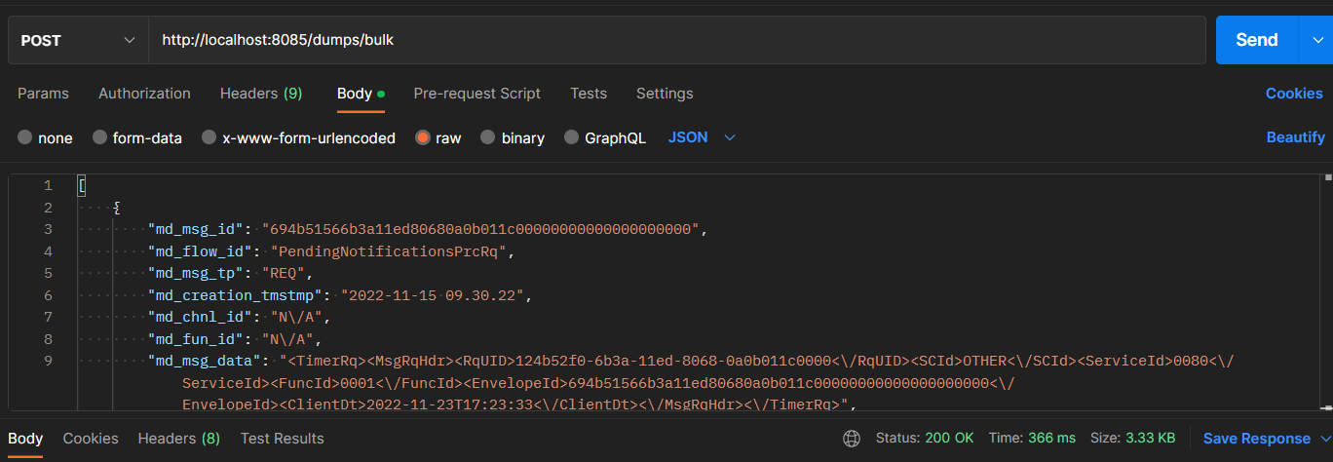
Microservice Capabilities
Update Record
Bulk Insertion

Slide 42
Sequential and Concurrent Performance
Introduction
Connecting the previous spring application to a dummy Postgres database and creating a dummy employee table.
In addition to implementing the required services and controllers to connect to it, we will be testing sequential and concurrent performance of the application with a few scenarios.

Slide 43
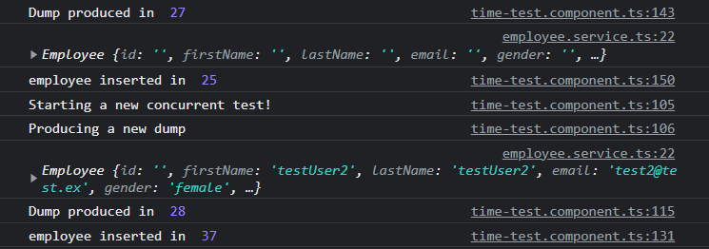
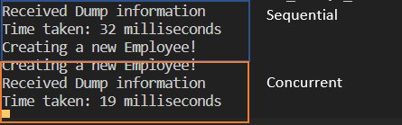
Sequential and Concurrent Performance
Scenario 1
Produce a new Dump + Insert A New Employee in the database
 | Sequential | Concurrent
Total time | 84ms | 37ms

Slide 44
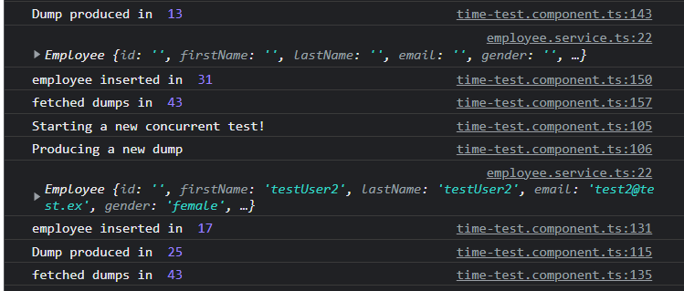

Sequential and Concurrent Performance
Scenario 2
Produce Dump + Employee Insertion + get dumps
 | Sequential | Concurrent
Total Time | 171ms | 43ms

Slide 45
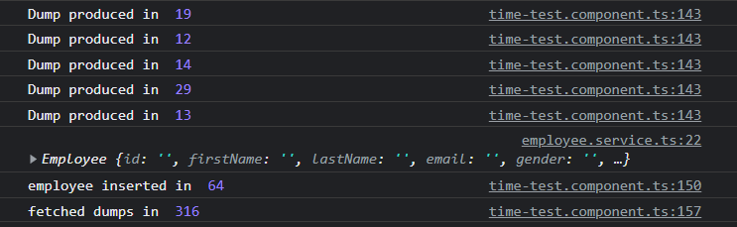
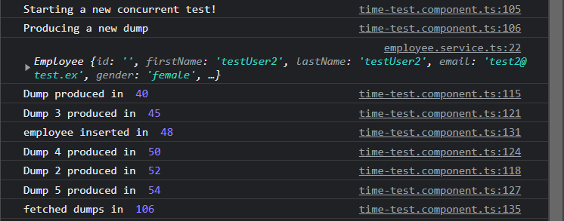
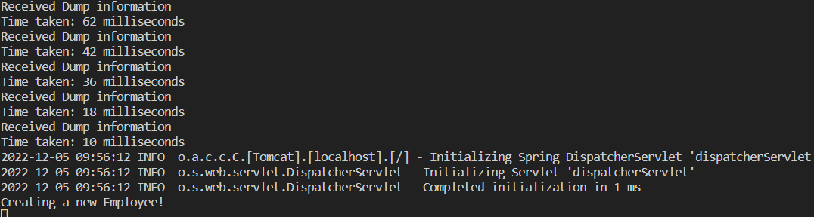
Sequential and Concurrent Performance
Scenario 3
Produce multiple dumps + Insert a new employee in the database + get all dumps
 | Sequential | Concurrent
Total Time | 379ms | 106ms

Slide 46
Sequential and Concurrent Performance
Scenario 4
Produce multiple dumps + multiple employee insertion + get all dumps
 | Sequential | Concurrent
Total Time | 363ms | 172ms

Slide 47
Sequential and Concurrent Performance
Scenario 5
Same as scenario 4, but with more insertions and productions
 | Sequential | Concurrent
Total Time | 770ms | 223ms

Slide 48
Scalability Performance
There are several performance considerations and tradeoffs with respect to shard size and the number of primary shards configured for an index.
The more shards, the more overhead there is simply in maintaining those indices.
The larger the shard size, the longer it takes to move shards around when Elasticsearch needs to rebalance a cluster.

Slide 49
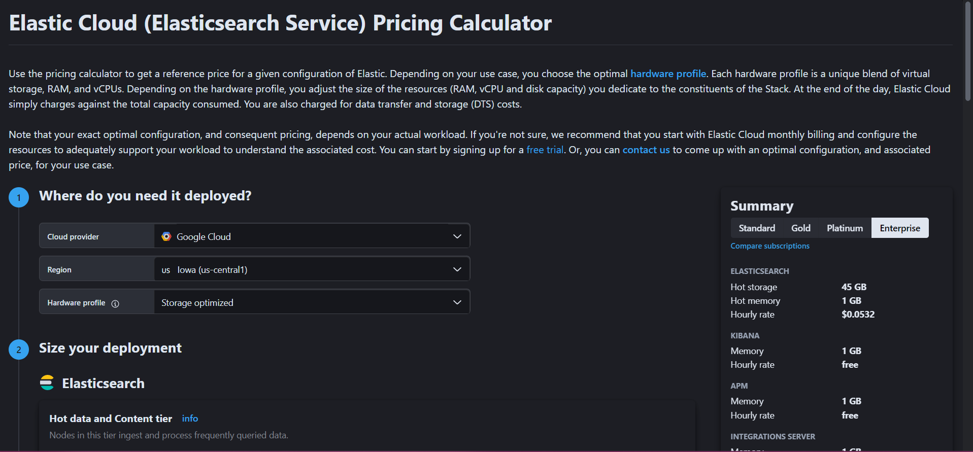
Pricing
Elastic Search
There are two options:
Managed hosting from elastic.co, they charge you according to several variables. You can find the pricing here: ELK Stack Pricing
Use the open-source version, stand up your own servers and manage your own deployment, the code is at no cost and can be found here: Elastic Search Open Source
There is also a pricing calculator in case we need to calculate specific pricing: Elastic Pricing Calculator
Kibana
Kibana pricing is included in Elasticsearch pricing calculator. Kibana is free to use under either the Elastic license or SSPL. Additional free features are available under the Elastic license.
Kibana can also be set up locally.

Slide 50
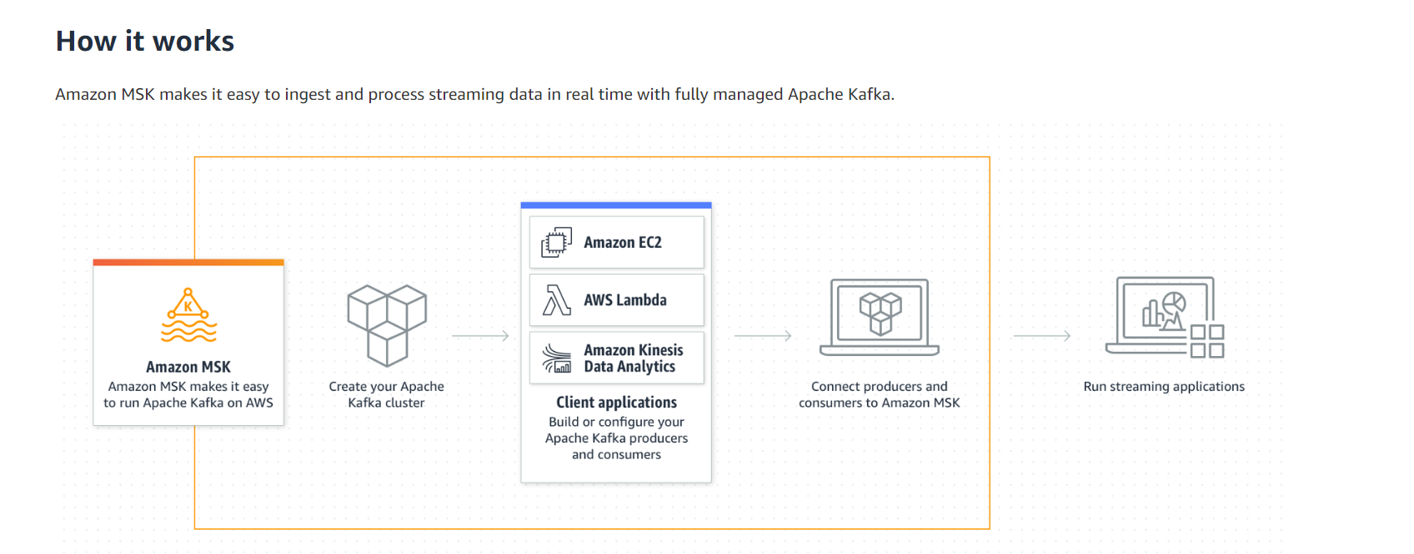
Pricing
Kafka
Apache Kafka is free.
For hosting, some platforms like AWS offer Amazon MSK for managed Kafka hosting, other places offer kafka hosting too.
Example for hosting on AWS: Amazon MSK Pricing

Slide 51
DB recommended type(NoSQL)
Elastic Search itself is completely open source and built in Java. It is not built on another database.
Lucene or Apache Lucene is an open-source Java library used as a search engine. Elasticsearch is built on top of Lucene.
Elasticsearch converts Lucene into a distributed system/search engine for scaling horizontally. Elasticsearch also provides other features like thread-pool, queues, node/cluster monitoring API, data monitoring API, Cluster management, etc. In short, Elasticsearch extends Lucene and provides additional features beyond it.
Elastic Search & Lucene

Slide 52
Multi-threaded performance
We will be using Apache JMeter for load testing to calculate time taken for production, consumption and insertion into ES.
Case 1: One Kafka Broker and One Elastic Search Node
Insertion Only
Insertion + Update
The number of dumps/sec are separated into half for update and half for insertion
Number of Dumps | Ramp-up Period | Time Taken | Error Rate
1000 | 1 second | 21 seconds | 0%
2000 | 1 second | 39 seconds | 0%
3000 | 3 seconds | 46 seconds | 3.13%
Number of Dumps | Ramp-up Period | Time Taken | Error Rate
1000 | 1 second | 12 seconds | 0%
2000 | 1 second | 27 seconds | 0%
3000 | 1 second | 37 seconds | 0%

Slide 53
Multi-threaded performance
We will be using Apache JMeter for load testing.
Case 2: Kafka Cluster with Three Brokers and One Elastic Search Node
Insertion Only
Insertion + Update
The number of dumps/sec are separated into half for update and half for insertion
Number of Dumps | Ramp-up Period | Time Taken | Error Rate
1000 | 1 second | 18 seconds | 0%
2000 | 1 second | 39 seconds | 0%
3000 | 3 seconds | 46 seconds | 5.17%
Number of Dumps | Ramp-up Period | Time Taken f | Error Rate
1000 | 1 second | 18 seconds | 0%
2000 | 1 second | 37 seconds | 0%

Slide 54
Multi-threaded performance
We will be using Apache JMeter for load testing.
Case 3: Kafka Cluster with Three Brokers and Two Elastic Search Nodes
Insertion Only
Insertion + Update
The number of dumps/sec are separated into half for update and half for insertion
Number of Dumps | Ramp-up Period | Time Taken | Error Rate
1000 | 1 second | 27 seconds | 0%
2000 | 1 second | 58 seconds | 1.17%
3000 | 2 seconds | 1 minute 22 seconds | 4.8%
Number of Dumps | Ramp-up Period | Time Taken | Error Rate
1000 | 2 seconds | 37 seconds | 0%
2000 | 3 seconds | 70 seconds | 4%

Slide 55
Multi-threaded performance
We will be using Apache JMeter for load testing.
Case 4: One Kafka Broker and Two Elastic Search Nodes
Insertion Only
Insertion + Update
The number of dumps/sec are separated into half for update and half for insertion
Number of Dumps | Ramp-up Period | Time Taken | Error Rate
1000 | 1 second | 35 seconds | 0%
2000 | 2 seconds | 71 seconds | 0%
3000 | 2 seconds | 124 seconds | 0%
Number of Dumps | Ramp-up Period | Time Taken | Error Rate
1000 | 1 second | 51 seconds | 0%
2000 | 1 second | 91 seconds | 0%

Slide 56
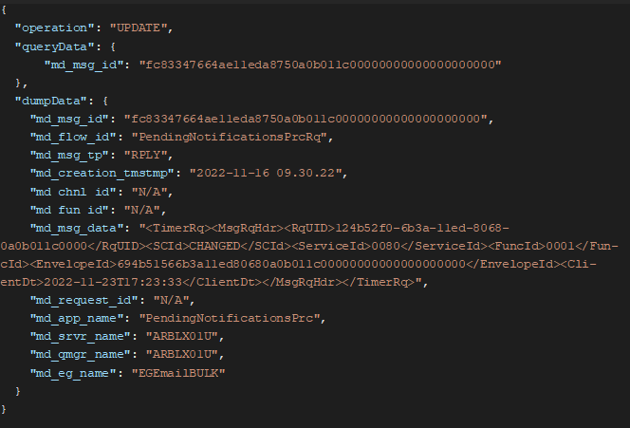
Updating Data Based On Business Key
Suggestion: change schema of document inserted into Kafka to reflect the operation to be done, to make usage of Kafka flexible.
Example:
Instead of inserting just the document that needs to be inserted into the Elastic Search index, the object sent to Kafka should contain the operation to be done, the business key if something should be updated/deleted, and the object to insert/update

Slide 57
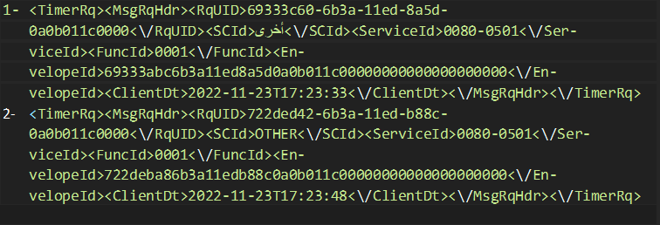
Transnationality Of Log Messages
Elastic Search supports multiple languages. It also supports searching through text that contains multiple languages.
For example, Here are some sample XML strings
We will tokenize these example strings by SCId, then try to search for the SCId once in English and once in Arabic.

Slide 58

Transnationality Of Log Messages
Searching In Arabic

Slide 59

Transnationality Of Log Messages
Searching In English

Slide 60
Transnationality Of Log Messages
Also, Elastic Search supports using the multi-fields feature. It is often useful to index the same field in different ways for different purposes.
For instance, a string field could be mapped as a text field for full-text search, and as a keyword field for sorting or aggregations.
Another use case of multi-fields is to analyze the same field in different ways for better relevance.
For instance we could index a field with the standard analyzer which breaks text up into words, and again with the English which stems words into their root form. This could be useful to us if we want to analyze the md_msg_data field in different ways for example.
For more info, check Elastic Search - Multi Fields

Slide 61
Fault Tolerance
Elastic Search
Primary Shards can be replicated so that in case it fails, one of the replicas will be in its place. (enabled by default in Elastic Search)
As nodes join or leave a cluster, the cluster automatically reorganizes itself to evenly distribute the data across the available nodes.
You add nodes to a cluster to increase its capacity and reliability.
We can spread the nodes into multiple availability zones so that if one zone is unavailable, we can still find the data in another zone.

Slide 62
Fault Tolerance
Kafka
Broker
We could have multiple brokers, and fault tolerance is done by copying the partition data to other brokers which are known as replicas.
There is a configuration that specifies how many copies of the partition you need. It’s called a replication factor.
Each broker will hold one or more partitions. And each of these partitions can either be a replica or leader for the topic.
All the writes and reads to a topic go through the leader and the leader coordinates to update replicas with new data.
Kafka Zookeeper is the multi-cluster controller of Kafka Clusters. Kafka uses Zookeeper to do leadership election of Kafka Broker and Topic Partition pairs and to manage service discovery for Kafka Brokers that form the cluster. Zookeeper sends changes of the topology to Kafka, so each node in the cluster knows when a new broker joined, a Broker died, a topic was removed or a topic was added, etc. Zookeeper provides an in-sync view of Kafka Cluster configuration.

Slide 63


Fault Tolerance

Slide 64

Fault Tolerance
Kafka
Producer
Approach 1
Here in this approach when the brokers in the cluster fail to meets the producer configurations like acks and min.insync.replicas or other Kafka meta-data failures related to brokers, those events are produced to recovery or retry topic. With the help of a Kafka consumer in the same application, those are polled and sent to the producer for retying.
This approach is not recommended because the Kafka cluster itself can be unavailable then retry topic cannot be helpful.

Slide 65

Fault Tolerance
Kafka
Producer
Approach 2
In this approach, the retry-able events are saved to a database, with the help of a scheduler process the event records are pulled from the database and passed to the producer for retrying.
This is more reliable than the first approach in case of cluster unavailability.
For reference check: Kafka Producer Error Handling and Recovery

Slide 66


Fault Tolerance
Kafka
Consumer

Slide 67
Fault Tolerance
Kafka
Duplicate Avoidance
To turn on this feature and get exactly-once semantics per partition—meaning no duplicates, no data loss, and in-order semantics—configure your producer to set “enable.idempotence=true”.
This feature adds negligible performance overhead over the non-idempotent producer.
In case of the consumer, Duplicate messages may be handled in several ways: implement an idempotent message handler or tracking all received messages and discard duplicate ones.
For more information: Check Handling Duplicate Messages and Message Ordering in Kafka
Exactly Once Processing In Kafka Explained

Slide 68

Deployment Model

Slide 69
Logstash VS Kafka
Kafka is deployed between the shipper and the indexer, acting as an entry point for the data being collected.
Kafka is much more powerful than Logstash. For syncing data from such as PostgreSQL to Elastic Search, Kafka connectors could do similar work with Logstash.
Kafka is a cluster, while Logstash is basically single instance. You could run multiple Logstash instances. But these Logstash instances are not aware of each other. For example, if one instance goes down, others will not take over its work. Kafka handles the node down automatically. And if you set up Kafka connectors to work in the distributed mode, other connectors could take over the work of the down connector.
Kafka and Logstash could also work together. For example, run a Logstash instance on every node to collect logs, and send the logs to Kafka. Then you could write the Kafka consumer code to do any handling you want.
In our case, Logstash can take data from Kafka topic and send it to elastic search, which isn’t any different than what we do now.

Slide 70

IBM Event Streams in a Nutshell
Built on Apache Kafka, IBM Event Streams is a high-throughput, fault-tolerant, event streaming platform that helps you build intelligent, responsive, event-driven applications.
It provides:
Apache Kafka deployment maximizes the spread of Kafka brokers across the nodes of IBM Cloud Private Cluster.
Health check information and opportunities to solve issues with the brokers and clusters.
Security with authorization and authentication using IBM Cloud Private.
Geo-replication of topics between clusters to support high availability and scalability.
UI for browsing messages to view and filter thousands of messages.
Encrypted communication between internal components and encrypted storage by using IBM Cloud Private.
Can help us in adding a schema for the data inserted in Kafka

